Slide 1

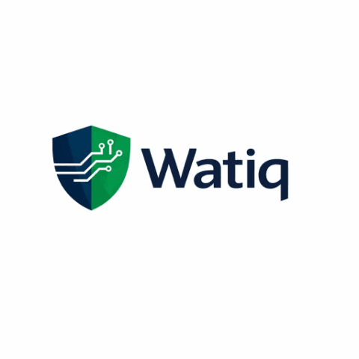
WatiqAI: Revolutionizing KYC with AI-Powered Document Intelligence
Securing the Future of Moroccan Banking through Real-Time Fraud Detection
Presented by: Manus AI
Date: February 2026
"Authenticity at the Speed of Digital"

Slide 2

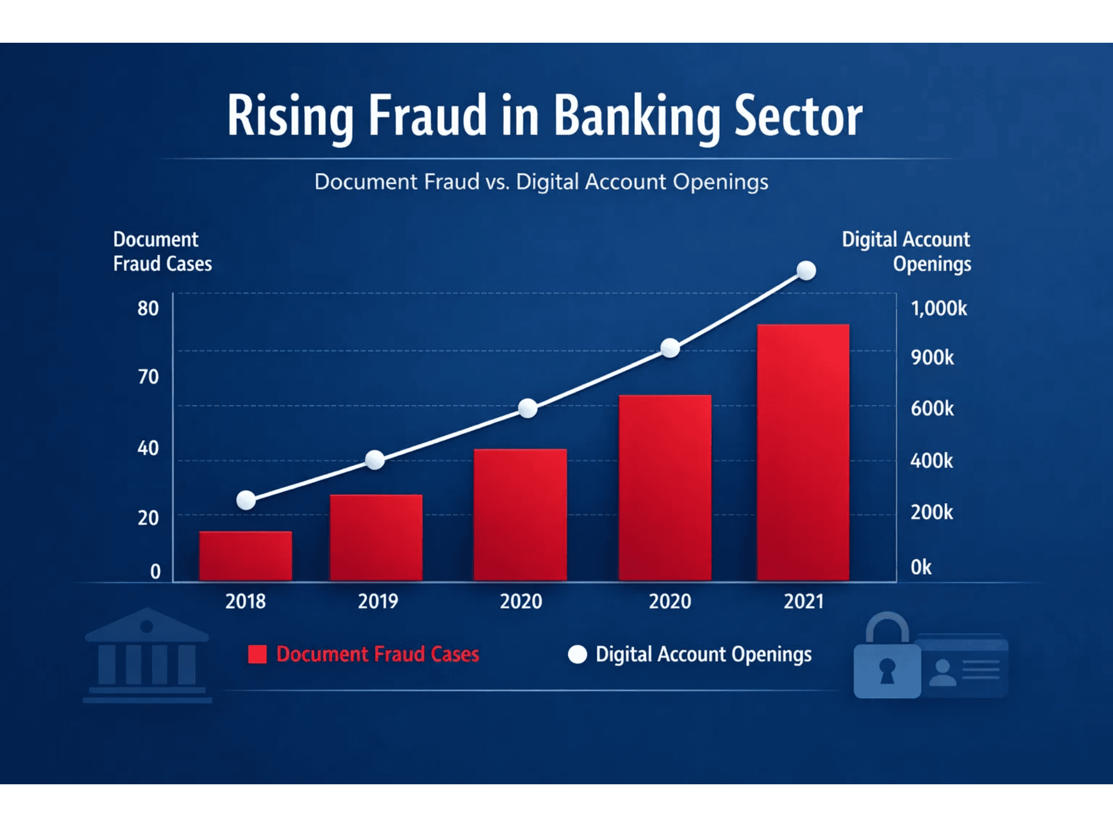



Moroccan Banks Lose 50M MAD Annually to Document Fraud
Inefficient Manual Processes
KYC verification takes 15-30 minutes per customer, costing 50-100 MAD per verification with high error rates.
Digital Surge
250%+ increase in digital account openings since COVID-19, overwhelming legacy manual systems.
Demographic Pressure
60% of Moroccans are under 30, demanding instant, secure, and mobile-first onboarding experiences.

Slide 3
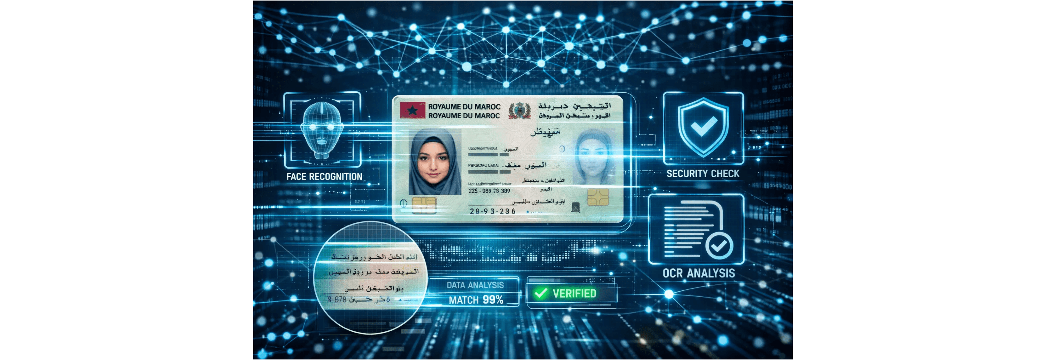
WatiqAI: AI-Powered Document Intelligence Built for Morocco
The Localized Solution for Global Security Standards
Real-time detection of forged, altered, or inconsistent identity documents, purpose-built for Moroccan IDs and regulatory requirements.

Slide 4




Multi-Modal AI Engine Detects Fraud Beyond Human Capability
Computer Vision
OCR & NLP
Identifies physical tampering, photo swaps, and fake security seals using YOLOv8 and EfficientNet architectures.
Cross-validates data across documents in Arabic, French, and Darija using Tesseract and AraBERT for semantic consistency.
Biometric Matching
Linguistic Intelligence
Compares selfie photos with ID photos using FaceNet and ArcFace, featuring robust liveness detection to prevent spoofing.
Understands Moroccan naming conventions and landmark-based address formats, reducing false positives in local contexts.
WatiqAI provides explainable risk scores (0-100) with detailed triggers for every verification.

Slide 5
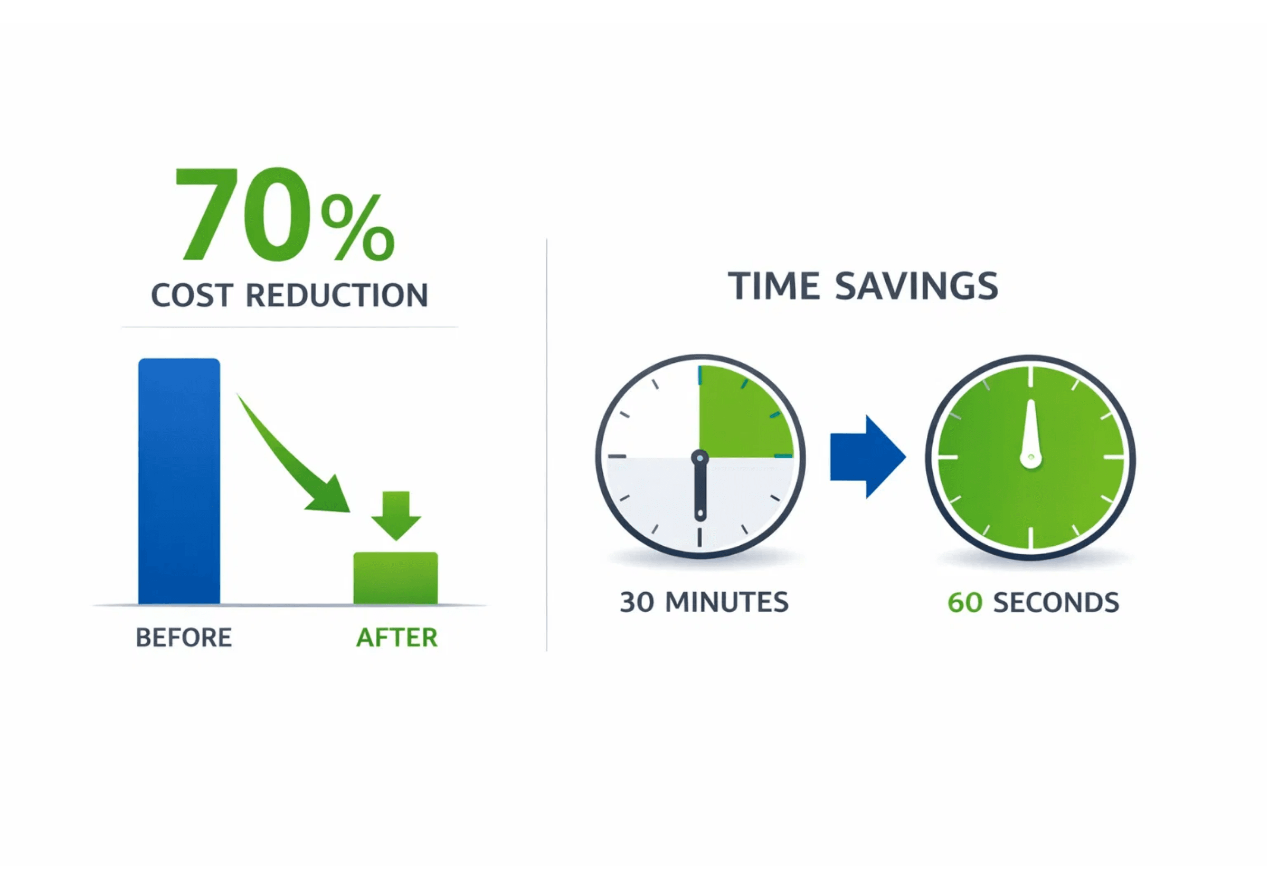



WatiqAI Delivers Immediate ROI and Regulatory Peace of Mind
70% Cost Reduction
Significant reduction in manual verification overhead, allowing banks to scale onboarding without increasing headcount.
Fraud Prevention ROI
Each prevented fraud saves an average of 15,000 MAD in investigation, chargebacks, and regulatory fines.
Regulatory Alignment
Audit-Ready Reporting
Fully aligned with Bank Al-Maghrib Circular 42/G/2020 and Law 09-08 requirements.

Slide 6




A Massive Market Opportunity Across Multiple Sectors
Banking & Microfinance
200K+ monthly KYC verifications across 19 banks and 35 microfinance institutions in Morocco alone.
Telecom & Insurance
High demand for secure, automated identity verification to reduce fraud and operational overhead.
Regional Vision
Scalable platform ready to become the leading identity verification provider across the Pan-Maghreb region.

Slide 7

Clear 3-Month Path to a Production-Ready MVP
Month 1: Foundation
Month 2: Development
Month 3: Launch
Data acquisition (5,000+ Moroccan documents), infrastructure setup, and core OCR/Face matching model training.
Implementation of 10+ Moroccan-specific fraud rules, anomaly detection models, and risk scoring engine.
API finalization, comprehensive testing with 500+ cases, and pilot program launch with a partner bank.
Beyond the MVP: Scaling the Impact
Expansion to Pan-Maghreb markets (Algeria, Tunisia, Mauritania) and multi-sector deployment in Telecom, Insurance, and Government.

Slide 8
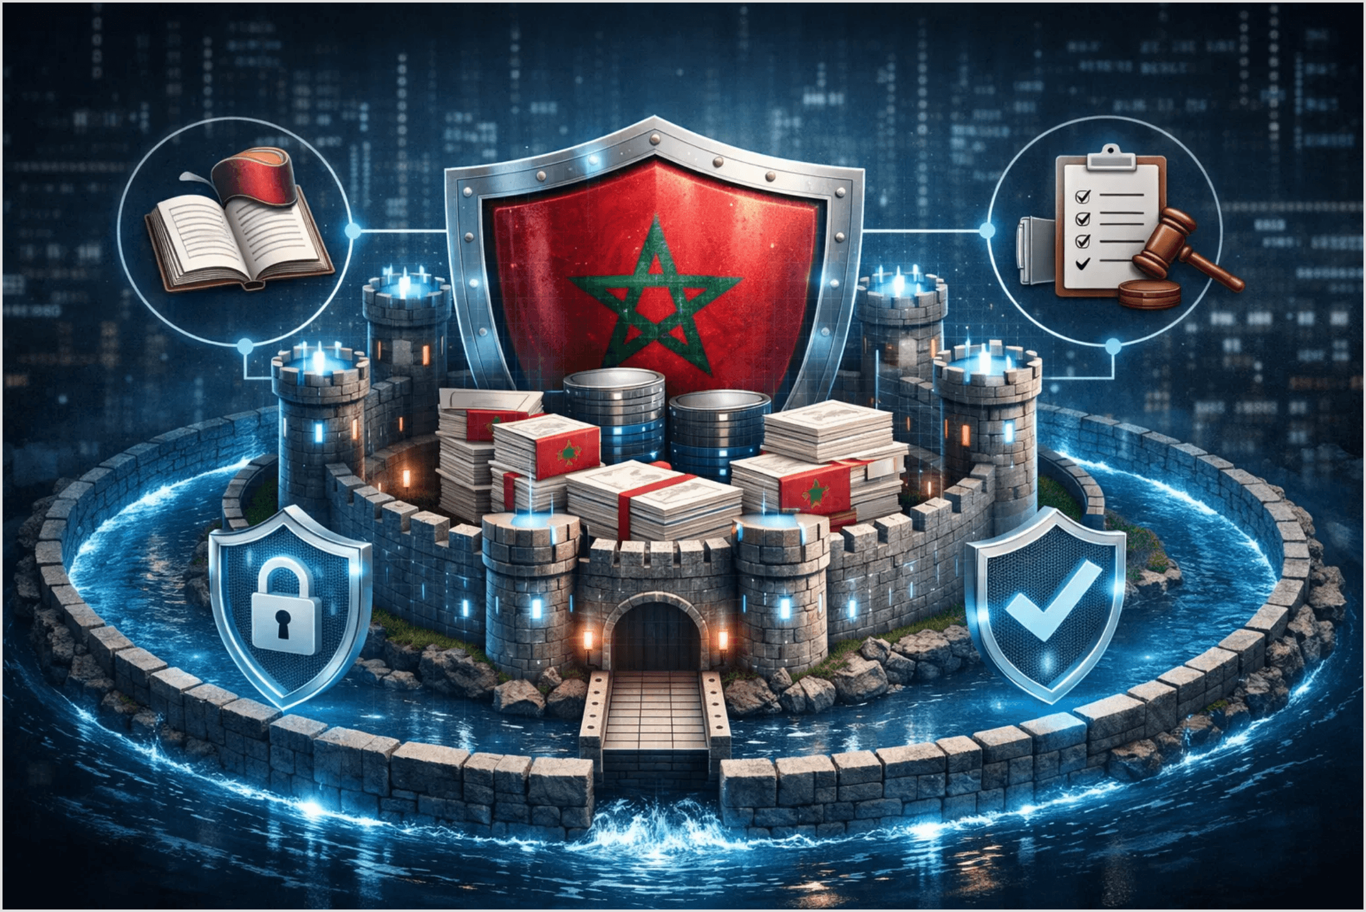




First-Mover Advantage with Deep Local Expertise
Deep Localization
Optimized for Moroccan docs, Arabic/Darija and local naming.
Proprietary Data
Growing database of local fraud patterns.
Regulatory Alignment
Built-in compliance with Bank Al‑Maghrib and Law 09‑08.
Scalability
Proven stack ready for rapid Pan‑Maghreb expansion.

Slide 9

Join Us in Shaping the Bank of Tomorrow
"Let's build a smarter, more connected, and secure banking experience together."
Contact: [Your Email / Phone Number]
Website: [Your Website URL]
Partner with WatiqAI to Secure the Future of Finance

